Slide 1
Normal Probability Distributions
Chapter 5

Slide 2
§ 5.1
Introduction to Normal Distributions and the Standard Distribution

Slide 3
Properties of Normal Distributions
A continuous random variable has an infinite number of possible values that can be represented by an interval on the number line.
Hours spent studying in a day
0
3
6
9
12
15
18
21
24
The time spent studying can be any number between 0 and 24.
The probability distribution of a continuous random variable is called a continuous probability distribution.

Slide 4
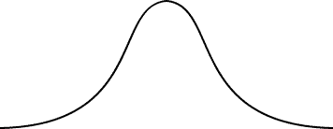
Properties of Normal Distributions
The most important probability distribution in statistics is the normal distribution.
Normal curve
x
A normal distribution is a continuous probability distribution for a random variable, x. The graph of a normal distribution is called the normal curve.

Slide 5
Properties of Normal Distributions
Properties of a Normal Distribution
The mean, median, and mode are equal.
The normal curve is bell-shaped and symmetric about the mean.
The total area under the curve is equal to one.
The normal curve approaches, but never touches the x-axis as it extends farther and farther away from the mean.
Between μ − σ and μ + σ (in the center of the curve), the graph curves downward. The graph curves upward to the left of μ − σ and to the right of μ + σ. The points at which the curve changes from curving upward to curving downward are called the inflection points.

Slide 6
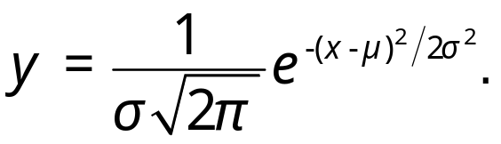

Properties of Normal Distributions
Inflection points
Total area = 1
x
μ − 3σ
μ − 2σ
μ − σ
μ
μ + σ
μ + 2σ
μ + 3σ
If x is a continuous random variable having a normal distribution with mean μ and standard deviation σ, you can graph a normal curve with the equation

Slide 7
Means and Standard Deviations
A normal distribution can have any mean and any positive standard deviation.
Inflection points
The mean gives the location of the line of symmetry.
Inflection points
x
x
1
2
3
4
5
6
1
2
3
4
5
6
7
8
9
10
11
Mean: μ = 3.5
Standard deviation: σ ≈ 1.3
Mean: μ = 6
Standard deviation: σ ≈ 1.9
The standard deviation describes the spread of the data.

Slide 8
Means and Standard Deviations
Example:
Which curve has the greater mean?
Which curve has the greater standard deviation?
B
A
x
1
3
5
7
9
11
13
The line of symmetry of curve A occurs at x = 5. The line of symmetry of curve B occurs at x = 9. Curve B has the greater mean.
Curve B is more spread out than curve A, so curve B has the greater standard deviation.

Slide 9
Interpreting Graphs
Example:
The heights of fully grown magnolia bushes are normally distributed. The curve represents the distribution. What is the mean height of a fully grown magnolia bush? Estimate the standard deviation.
The inflection points are one standard deviation away from the mean.
μ = 8
σ ≈ 0.7
x
6
7
8
9
10
Height (in feet)
The heights of the magnolia bushes are normally distributed with a mean height of about 8 feet and a standard deviation of about 0.7 feet.

Slide 10
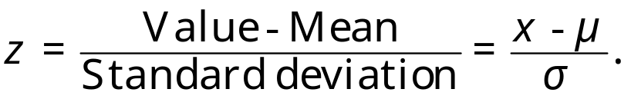
The Standard Normal Distribution
The standard normal distribution is a normal distribution with a mean of 0 and a standard deviation of 1.
The horizontal scale corresponds to z-scores.
z
−3
−2
−1
0
1
2
3
Any value can be transformed into a z-score by using the formula

Slide 11
The Standard Normal Distribution
If each data value of a normally distributed random variable x is transformed into a z-score, the result will be the standard normal distribution.
The area that falls in the interval under the nonstandard normal curve (the x-values) is the same as the area under the standard normal curve (within the corresponding z-boundaries).
z
−3
−2
−1
0
1
2
3
After the formula is used to transform an x-value into a z-score, the Standard Normal Table in Appendix B is used to find the cumulative area under the curve.

Slide 12
The Standard Normal Table
Properties of the Standard Normal Distribution
The cumulative area is close to 0 for z-scores close to z = −3.49.
The cumulative area increases as the z-scores increase.
The cumulative area for z = 0 is 0.5000.
The cumulative area is close to 1 for z-scores close to z = 3.49
Area is close to 0.
Area is close to 1.
z
z = −3.49
−3
−2
−1
0
1
2
3
z = 3.49
z = 0
Area is 0.5000.

Slide 13
The Standard Normal Table
Example:
Find the cumulative area that corresponds to a z-score of 2.71.
Appendix B: Standard Normal Table
z | .00 | .01 | .02 | .03 | .04 | .05 | .06 | .07 | .08 | .09
0.0 | .5000 | .5040 | .5080 | .5120 | .5160 | .5199 | .5239 | .5279 | .5319 | .5359
0.1 | .5398 | .5438 | .5478 | .5517 | .5557 | .5596 | .5636 | .5675 | .5714 | .5753
0.2 | .5793 | .5832 | .5871 | .5910 | .5948 | .5987 | .6026 | .6064 | .6103 | .6141
2.6 | .9953 | .9955 | .9956 | .9957 | .9959 | .9960 | .9961 | .9962 | .9963 | .9964
2.7 | .9965 | .9966 | .9967 | .9968 | .9969 | .9970 | .9971 | .9972 | .9973 | .9974
2.8 | .9974 | .9975 | .9976 | .9977 | .9977 | .9978 | .9979 | .9979 | .9980 | .9981
Find the area by finding 2.7 in the left hand column, and then moving across the row to the column under 0.01.
The area to the left of z = 2.71 is 0.9966.

Slide 14
The Standard Normal Table
Example:
Find the cumulative area that corresponds to a z-score of −0.25.
Appendix B: Standard Normal Table
z | .09 | .08 | .07 | .06 | .05 | .04 | .03 | .02 | .01 | .00
−3.4 | .0002 | .0003 | .0003 | .0003 | .0003 | .0003 | .0003 | .0003 | .0003 | .0003
−3.3 | .0003 | .0004 | .0004 | .0004 | .0004 | .0004 | .0004 | .0005 | .0005 | .0005
−0.3 | .3483 | .3520 | .3557 | .3594 | .3632 | .3669 | .3707 | .3745 | .3783 | .3821
−0.2 | .3859 | .3897 | .3936 | .3974 | .4013 | .4052 | .4090 | .4129 | .4168 | .4207
−0.1 | .4247 | .4286 | .4325 | .4364 | .4404 | .4443 | .4483 | .4522 | .4562 | .4602
−0.0 | .4641 | .4681 | .4724 | .4761 | .4801 | .4840 | .4880 | .4920 | .4960 | .5000
Find the area by finding −0.2 in the left hand column, and then moving across the row to the column under 0.05.
The area to the left of z = −0.25 is 0.4013

Slide 15
Guidelines for Finding Areas
Finding Areas Under the Standard Normal Curve
Sketch the standard normal curve and shade the appropriate area under the curve.
Find the area by following the directions for each case shown.
  To find the area to the left of z, find the area that corresponds to z in the Standard Normal Table.
2. The area to the left of z = 1.23 is 0.8907.
z
0
1.23
1. Use the table to find the area for the z-score.

Slide 16
Guidelines for Finding Areas
Finding Areas Under the Standard Normal Curve
  To find the area to the right of z, use the Standard Normal Table to find the area that corresponds to z. Then subtract the area from 1.
2. The area to the left of z = 1.23 is 0.8907.
3. Subtract to find the area to the right of z = 1.23: 1 − 0.8907 = 0.1093.
z
0
1.23
1. Use the table to find the area for the z-score.

Slide 17
Guidelines for Finding Areas
Finding Areas Under the Standard Normal Curve
  To find the area between two z-scores, find the area corresponding to each z-score in the Standard Normal Table. Then subtract the smaller area from the larger area.
2. The area to the left of z = 1.23 is 0.8907.
4. Subtract to find the area of the region between the two z-scores: 0.8907 − 0.2266 = 0.6641.
3. The area to the left of z = −0.75 is 0.2266.
z
−0.75
0
1.23
1. Use the table to find the area for the z-score.

Slide 18
Guidelines for Finding Areas
Example:
Find the area under the standard normal curve to the left of z = −2.33.
Always draw the curve!
z
−2.33
0
From the Standard Normal Table, the area is equal to 0.0099.

Slide 19
Guidelines for Finding Areas
Example:
Find the area under the standard normal curve to the right of z = 0.94.
Always draw the curve!
0.8264
1 − 0.8264 = 0.1736
z
0
0.94
From the Standard Normal Table, the area is equal to 0.1736.

Slide 20
Guidelines for Finding Areas
Example:
Find the area under the standard normal curve between z = −1.98 and z = 1.07.
Always draw the curve!
0.8577
0.8577 − 0.0239 = 0.8338
0.0239
z
−1.98
0
1.07
From the Standard Normal Table, the area is equal to 0.8338.

Slide 21
§ 5.2
Normal Distributions: Finding Probabilities

Slide 22
Probability and Normal Distributions
If a random variable, x, is normally distributed, you can find the probability that x will fall in a given interval by calculating the area under the normal curve for that interval.
μ = 10
σ = 5
P(x < 15)
x
μ =10
15

Slide 23
Probability and Normal Distributions
Normal Distribution
Standard Normal Distribution
μ = 10
σ = 5
μ = 0
σ = 1
P(x < 15)
P(z < 1)
x
z
μ =10
15
μ =0
1
Same area
P(x < 15) = P(z < 1) = Shaded area under the curve
= 0.8413

Slide 24
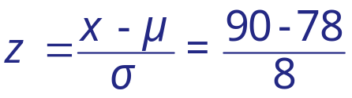

Probability and Normal Distributions
Example:
The average on a statistics test was 78 with a standard deviation of 8. If the test scores are normally distributed, find the probability that a student receives a test score less than 90.
μ = 78
σ = 8
P(x < 90)
The probability that a student receives a test score less than 90 is 0.9332.
x
μ =78
90
z
μ =0
?
1.5
P(x < 90) = P(z < 1.5) = 0.9332

Slide 25
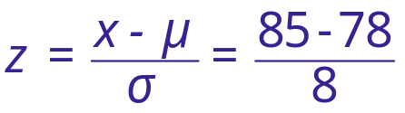

Probability and Normal Distributions
Example:
The average on a statistics test was 78 with a standard deviation of 8. If the test scores are normally distributed, find the probability that a student receives a test score greater than than 85.
μ = 78
σ = 8
P(x > 85)
The probability that a student receives a test score greater than 85 is 0.1894.
x
μ =78
85
z
μ =0
0.88
?
P(x > 85) = P(z > 0.88) = 1 − P(z < 0.88) = 1 − 0.8106 = 0.1894

Slide 26
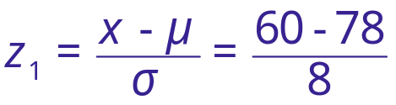

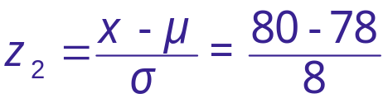

Probability and Normal Distributions
Example:
The average on a statistics test was 78 with a standard deviation of 8. If the test scores are normally distributed, find the probability that a student receives a test score between 60 and 80.
P(60 < x < 80)
μ = 78
σ = 8
The probability that a student receives a test score between 60 and 80 is 0.5865.
x
60
μ =78
80
z
−2.25
μ =0
0.25
?
?
P(60 < x < 80) = P(−2.25 < z < 0.25) = P(z < 0.25) − P(z < −2.25)
= 0.5987 − 0.0122 = 0.5865

Slide 27
§ 5.3
Normal Distributions: Finding Values

Slide 28
Finding z-Scores
Example:
Find the z-score that corresponds to a cumulative area of 0.9973.
Appendix B: Standard Normal Table
z | .00 | .01 | .02 | .03 | .04 | .05 | .06 | .07 | .08 | .09
0.0 | .5000 | .5040 | .5080 | .5120 | .5160 | .5199 | .5239 | .5279 | .5319 | .5359
0.1 | .5398 | .5438 | .5478 | .5517 | .5557 | .5596 | .5636 | .5675 | .5714 | .5753
0.2 | .5793 | .5832 | .5871 | .5910 | .5948 | .5987 | .6026 | .6064 | .6103 | .6141
.08
2.6 | .9953 | .9955 | .9956 | .9957 | .9959 | .9960 | .9961 | .9962 | .9963 | .9964
2.7 | .9965 | .9966 | .9967 | .9968 | .9969 | .9970 | .9971 | .9972 | .9973 | .9974
2.8 | .9974 | .9975 | .9976 | .9977 | .9977 | .9978 | .9979 | .9979 | .9980 | .9981
2.7
Find the z-score by locating 0.9973 in the body of the Standard Normal Table. The values at the beginning of the corresponding row and at the top of the column give the z-score.
The z-score is 2.78.

Slide 29
Finding z-Scores
Example:
Find the z-score that corresponds to a cumulative area of 0.4170.
Appendix B: Standard Normal Table
z | .09 | .08 | .07 | .06 | .05 | .04 | .03 | .02 | .01 | .00
−3.4 | .0002 | .0003 | .0003 | .0003 | .0003 | .0003 | .0003 | .0003 | .0003 | .0003
−0.2 | .0003 | .0004 | .0004 | .0004 | .0004 | .0004 | .0004 | .0005 | .0005 | .0005
.01
Use the closest area.
−0.3 | .3483 | .3520 | .3557 | .3594 | .3632 | .3669 | .3707 | .3745 | .3783 | .3821
−0.2 | .3859 | .3897 | .3936 | .3974 | .4013 | .4052 | .4090 | .4129 | .4168 | .4207
−0.1 | .4247 | .4286 | .4325 | .4364 | .4404 | .4443 | .4483 | .4522 | .4562 | .4602
−0.0 | .4641 | .4681 | .4724 | .4761 | .4801 | .4840 | .4880 | .4920 | .4960 | .5000
−0.2
Find the z-score by locating 0.4170 in the body of the Standard Normal Table. Use the value closest to 0.4170.
The z-score is −0.21.

Slide 30
Finding a z-Score Given a Percentile
Example:
Find the z-score that corresponds to P₇₅.
Area = 0.75
z
μ =0
?
0.67
The z-score that corresponds to P₇₅ is the same z-score that corresponds to an area of 0.75.
The z-score is 0.67.

Slide 31




Transforming a z-Score to an x-Score
To transform a standard z-score to a data value, x, in a given population, use the formula
Example:
The monthly electric bills in a city are normally distributed with a mean of $120 and a standard deviation of $16. Find the x-value corresponding to a z-score of 1.60.
We can conclude that an electric bill of $145.60 is 1.6 standard deviations above the mean.

Slide 32



Finding a Specific Data Value
Example:
The weights of bags of chips for a vending machine are normally distributed with a mean of 1.25 ounces and a standard deviation of 0.1 ounce. Bags that have weights in the lower 8% are too light and will not work in the machine. What is the least a bag of chips can weigh and still work in the machine?
P(z < ?) = 0.08
8%
P(z < −1.41) = 0.08
z
?
0
−1.41
x
?
1.25
1.11
The least a bag can weigh and still work in the machine is 1.11 ounces.

Slide 33
§ 5.4
Sampling Distributions and the Central Limit Theorem

Slide 34
Sampling Distributions
A sampling distribution is the probability distribution of a sample statistic that is formed when samples of size n are repeatedly taken from a population.
Sample
Sample
Sample
Sample
Sample
Sample
Sample
Sample
Population
Sample
Sample

Slide 35
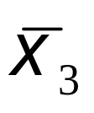
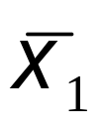
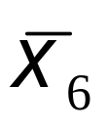
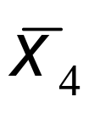
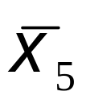
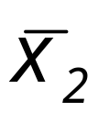
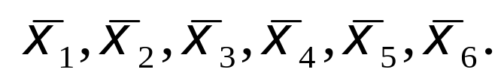
Sampling Distributions
If the sample statistic is the sample mean, then the distribution is the sampling distribution of sample means.
Sample 3
Sample 1
Sample 6
Sample 4
Sample 5
Sample 2
The sampling distribution consists of the values of the sample means,

Slide 36

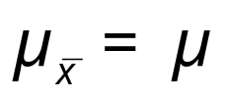


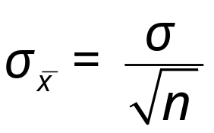
Properties of Sampling Distributions
Properties of Sampling Distributions of Sample Means
The mean of the sample means, is equal to the population mean.
The standard deviation of the sample means, is equal to the population standard deviation, divided by the square root of n.
The standard deviation of the sampling distribution of the sample means is called the standard error of the mean.

Slide 37



Sampling Distribution of Sample Means
Example:
The population values {5, 10, 15, 20} are written on slips of paper and put in a hat. Two slips are randomly selected, with replacement.
  Find the mean, standard deviation, and variance of the population.
Population
5
10
15
20
Continued.

Slide 38
Sampling Distribution of Sample Means
Example continued:
The population values {5, 10, 15, 20} are written on slips of paper and put in a hat. Two slips are randomly selected, with replacement.
  Graph the probability histogram for the population values.
P(x)
Probability Histogram of Population of x
0.25
This uniform distribution shows that all values have the same probability of being selected.
Probability
x
5
10
15
20
Population values
Continued.

Slide 39

Sampling Distribution of Sample Means
Example continued:
The population values {5, 10, 15, 20} are written on slips of paper and put in a hat. Two slips are randomly selected, with replacement.
  List all the possible samples of size n = 2 and calculate the mean of each.
Sample
Sample mean,
Sample
Sample mean,
5, 5
5
15, 5
10
These means form the sampling distribution of the sample means.
5, 10
7.5
15, 10
12.5
5, 15
10
15, 15
15
5, 20
12.5
15, 20
17.5
10, 5
7.5
20, 5
12.5
10, 10
10
20, 10
15
10, 15
12.5
20, 15
17.5
10, 20
15
20, 20
20
Continued.

Slide 40


Sampling Distribution of Sample Means
Example continued:
The population values {5, 10, 15, 20} are written on slips of paper and put in a hat. Two slips are randomly selected, with replacement.
  Create the probability distribution of the sample means.
5
1
0.0625
7.5
2
0.1250
Probability Distribution of Sample Means
10
3
0.1875
12.5
4
0.2500
15
3
0.1875
17.5
2
0.1250
20
1
0.0625

Slide 41

Sampling Distribution of Sample Means
Example continued:
The population values {5, 10, 15, 20} are written on slips of paper and put in a hat. Two slips are randomly selected, with replacement.
  Graph the probability histogram for the sampling distribution.
P(x)
Probability Histogram of Sampling Distribution
0.25
0.20
The shape of the graph is symmetric and bell shaped. It approximates a normal distribution.
Probability
0.15
0.10
0.05
5
7.5
10
12.5
15
17.5
20
Sample mean

Slide 42


The Central Limit Theorem
If a sample of size n ≥ 30 is taken from a population with any type of distribution that has a mean = μ and standard deviation = σ,
x
x
the sample means will have a normal distribution.

Slide 43
The Central Limit Theorem
If the population itself is normally distributed, with mean = μ and standard deviation = σ,
x
the sample means will have a normal distribution for any sample size n.

Slide 44
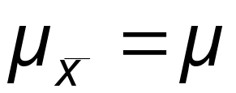
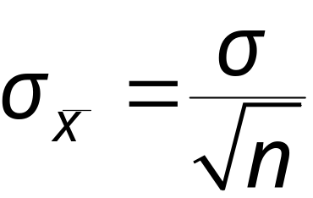
The Central Limit Theorem
In either case, the sampling distribution of sample means has a mean equal to the population mean.
Mean of the sample means
The sampling distribution of sample means has a standard deviation equal to the population standard deviation divided by the square root of n.
Standard deviation of the sample means
This is also called the standard error of the mean.

Slide 45
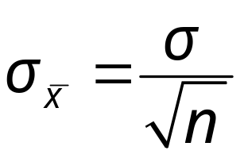
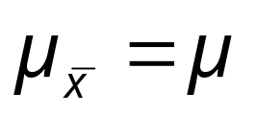

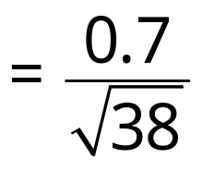

The Mean and Standard Error
Example:
The heights of fully grown magnolia bushes have a mean height of 8 feet and a standard deviation of 0.7 feet. 38 bushes are randomly selected from the population, and the mean of each sample is determined. Find the mean and standard error of the mean of the sampling distribution.
Standard deviation (standard error)
Mean
Continued.

Slide 46






Interpreting the Central Limit Theorem
Example continued:
The heights of fully grown magnolia bushes have a mean height of 8 feet and a standard deviation of 0.7 feet. 38 bushes are randomly selected from the population, and the mean of each sample is determined.
The mean of the sampling distribution is 8 feet ,and the standard error of the sampling distribution is 0.11 feet.
From the Central Limit Theorem, because the sample size is greater than 30, the sampling distribution can be approximated by the normal distribution.

Slide 47







Finding Probabilities
Example:
The heights of fully grown magnolia bushes have a mean height of 8 feet and a standard deviation of 0.7 feet. 38 bushes are randomly selected from the population, and the mean of each sample is determined.
The mean of the sampling distribution is 8 feet, and the standard error of the sampling distribution is 0.11 feet.
Find the probability that the mean height of the 38 bushes is less than 7.8 feet.
7.8
Continued.

Slide 48

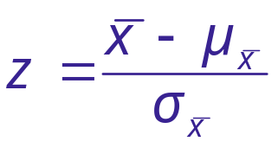

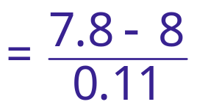







Finding Probabilities
Example continued:
Find the probability that the mean height of the 38 bushes is less than 7.8 feet.
P ( < 7.8)
7.8
−1.82
= 0.0344
P ( < 7.8) = P (z < ____ )
?
The probability that the mean height of the 38 bushes is less than 7.8 feet is 0.0344.

Slide 49
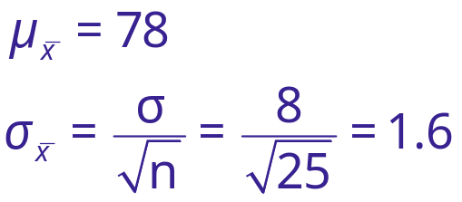
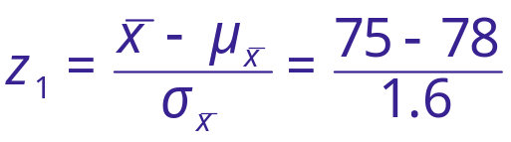

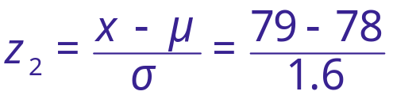



Probability and Normal Distributions
Example:
The average on a statistics test was 78 with a standard deviation of 8. If the test scores are normally distributed, find the probability that the mean score of 25 randomly selected students is between 75 and 79.
P (75 < < 79)
75
78
79
z
−1.88
0
0.63
Continued.
?
?

Slide 50
Probability and Normal Distributions
Example continued:
P (75 < < 79)
75
78
79
z
−1.88
0
0.63
?
?
P(75 < < 79) = P(−1.88 < z < 0.63) = P(z < 0.63) − P(z < −1.88)
= 0.7357 − 0.0301 = 0.7056
Approximately 70.56% of the 25 students will have a mean score between 75 and 79.

Slide 51
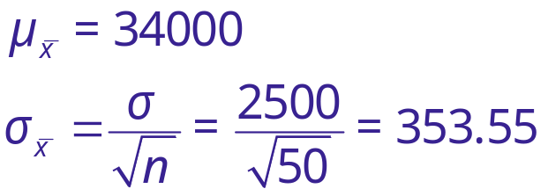
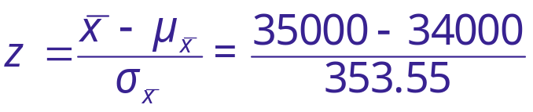

Probabilities of x and x
Example:
The population mean salary for auto mechanics is μ = $34,000 with a standard deviation of σ = $2,500. Find the probability that the mean salary for a randomly selected sample of 50 mechanics is greater than $35,000.
P ( > 35000)
= P (z > 2.83)
= 1 − P (z < 2.83)
= 1 − 0.9977
= 0.0023
The probability that the mean salary for a randomly selected sample of 50 mechanics is greater than $35,000 is 0.0023.
34000
35000
z
0
?
2.83

Slide 52
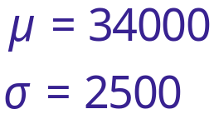
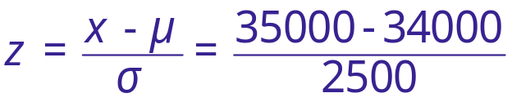

Probabilities of x and x
Example:
The population mean salary for auto mechanics is μ = $34,000 with a standard deviation of σ = $2,500. Find the probability that the salary for one randomly selected mechanic is greater than $35,000.
(Notice that the Central Limit Theorem does not apply.)
P (x > 35000)
= P (z > 0.4)
= 1 − P (z < 0.4)
= 1 − 0.6554
= 0.3446
The probability that the salary for one mechanic is greater than $35,000 is 0.3446.
34000
35000
z
0
?
0.4

Slide 53
Probabilities of x and x
Example:
The probability that the salary for one randomly selected mechanic is greater than $35,000 is 0.3446. In a group of 50 mechanics, approximately how many would have a salary greater than $35,000?
This also means that 34.46% of mechanics have a salary greater than $35,000.
P(x > 35000) = 0.3446
34.46% of 50 = 0.3446 × 50 = 17.23
You would expect about 17 mechanics out of the group of 50 to have a salary greater than $35,000.

Slide 54
§ 5.5
Normal Approximations to Binomial Distributions

Slide 55

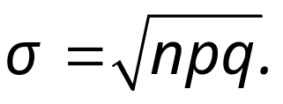
Normal Approximation
The normal distribution is used to approximate the binomial distribution when it would be impractical to use the binomial distribution to find a probability.
Normal Approximation to a Binomial Distribution
If np ≥ 5 and nq ≥ 5, then the binomial random variable x is approximately normally distributed with mean
and standard deviation

Slide 56




Normal Approximation
Example:
Decided whether the normal distribution to approximate x may be used in the following examples.
  Thirty-six percent of people in the United States own a dog. You randomly select 25 people in the United States and ask them if they own a dog.
  Fourteen percent of people in the United States own a cat. You randomly select 20 people in the United States and ask them if they own a cat.
Because np and nq are greater than 5, the normal distribution may be used.
Because np is not greater than 5, the normal distribution may NOT be used.

Slide 57

Correction for Continuity
The binomial distribution is discrete and can be represented by a probability histogram.
Exact binomial probability
To calculate exact binomial probabilities, the binomial formula is used for each value of x and the results are added.
P(x = c)
Normal approximation
P(c− 0.5 < x < c + 0.5)
c
When using the continuous normal distribution to approximate a binomial distribution, move 0.5 unit to the left and right of the midpoint to include all possible x-values in the interval.
c − 0.5
c
c + 0.5
This is called the correction for continuity.

Slide 58
Correction for Continuity
Example:
Use a correction for continuity to convert the binomial intervals to a normal distribution interval.
  The probability of getting between 125 and 145 successes, inclusive.
  The discrete midpoint values are 125, 126, …, 145.
  The continuous interval is 124.5 < x < 145.5.
  The probability of getting exactly 100 successes.
  The discrete midpoint value is 100.
  The continuous interval is 99.5 < x < 100.5.
  The probability of getting at least 67 successes.
  The discrete midpoint values are 67, 68, ….
  The continuous interval is x > 66.5.

Slide 59


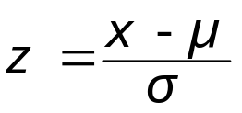
Guidelines
Using the Normal Distribution to Approximate Binomial Probabilities
In Words In Symbols
Verify that the binomial distribution applies.
Determine if you can use the normal distribution to approximate x, the binomial variable.
Find the mean μ and standard deviationσ for the distribution.
Apply the appropriate continuity correction. Shade the corresponding area under the normal curve.
Find the corresponding z-value(s).
Find the probability.
Specify n, p, and q.
Is np ≥ 5?
Is nq ≥ 5?
Add or subtract 0.5 from endpoints.
Use the Standard Normal Table.

Slide 60
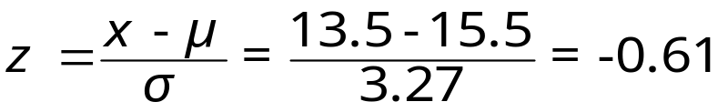
Approximating a Binomial Probability
Example:
Thirty-one percent of the seniors in a certain high school plan to attend college. If 50 students are randomly selected, find the probability that less than 14 students plan to attend college.
np = (50)(0.31) = 15.5
The variable x is approximately normally distributed with μ = np = 15.5 and
nq = (50)(0.69) = 34.5
P(x < 13.5)
= P(z < −0.61)
= 0.2709
Correction for continuity
μ= 15.5
13.5
x
10
15
20
The probability that less than 14 plan to attend college is 0.2079.

Slide 61

Approximating a Binomial Probability
Example:
A survey reports that forty-eight percent of US citizens own computers. 45 citizens are randomly selected and asked whether he or she owns a computer. What is the probability that exactly 10 say yes?
np = (45)(0.48) = 12
nq = (45)(0.52) = 23.4
P(9.5 < x < 10.5)
= P(−0.75 < z − 0.45)
μ = 12
= 0.0997
10.5
Correction for continuity
9.5
The probability that exactly 10 US citizens own a computer is 0.0997.
x
5
10
15

